Slide 1
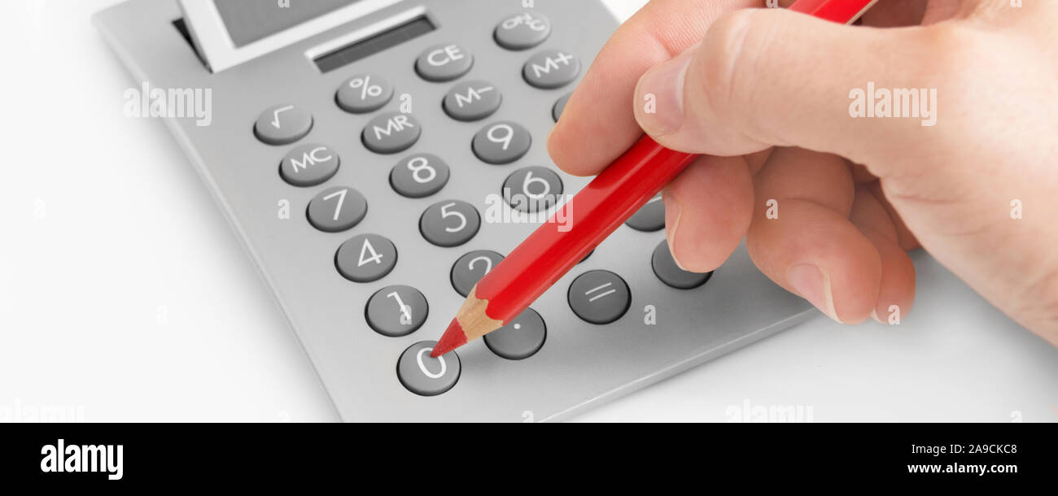
Project – Calculator Design in Python
Nexthikes IT Solutions
Presented By-Archana Goswami

Slide 2
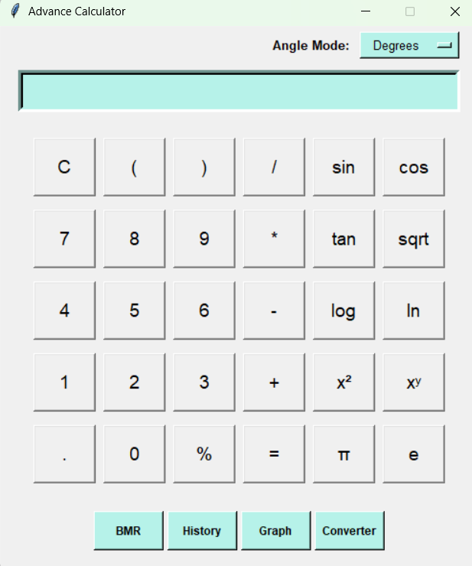
Project Overview
Project Goal
Technology
Build a user-friendly calculator that supports standard and advanced calculations, health-related BMR estimation, graph plotting and calculation history.
Python for application logic; Tkinter for the desktop interface; Matplotlib for graph plotting; standard Python modules for calculations and data handling.
Core Modules
Scientific Functions
BMR (Basal Metabolic Rate)
Graph Plotter
Converter
History

Slide 3
Application Design & Technology
USER INTERFACE
Tkinter windows, buttons, input fields, menus and result display
APPLICATION LOGIC
Input validation, expression handling, BMR calculation and history management
↓
Python math functions and Matplotlib graph library
CALCULATION & VISUALIZATION
↓
Keep each module independent so features can be tested, maintained without changing the entire application
KEY DESIGN IDEA

Slide 4
Scientific Calculator
Basic operations
Scientific functions
Addition, subtraction, multiplication, division, decimal values and percentage calculations.
Trigonometry (sin, cos, tan), logarithms, square roots, powers and factorials. Degree/Radian settings in case of Trigonometry functions.
Example calculations
√(144)
sin(30°)
log₁₀(1000)
5!
12
0.5
3
120

Slide 5
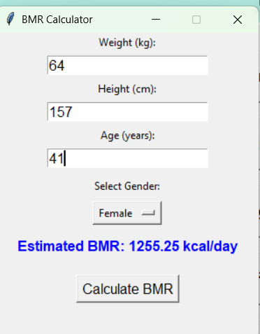
BMR Calculation
Inputs
Calculation
Output
Weight (kg)
Height (cm)
Age
Gender
Uses the Mifflin–St Jeor equation to estimate calories the body uses at rest per day.
Displays estimated BMR in kcal/day. It can be used as a starting point for broader energy-needs estimates.
Mifflin–St Jeor equation
Men: 10 × weight + 6.25 × height − 5 × age + 5
Women: 10 × weight + 6.25 × height − 5 × age − 161

Slide 6
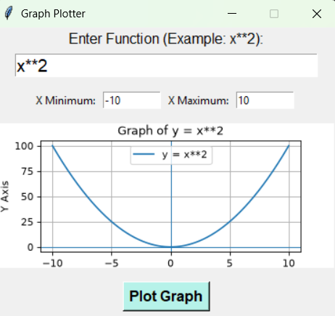
Graph Plotter
User inputs
Plot generation
Visual analysis
Enter a function of x, such as x² or 2*x + 1, and choose the x-range.
Generate x-values, evaluate the function safely, then plot the resulting points and axes.
Display grid, axis labels and graph title to help users understand function behavior

Slide 7
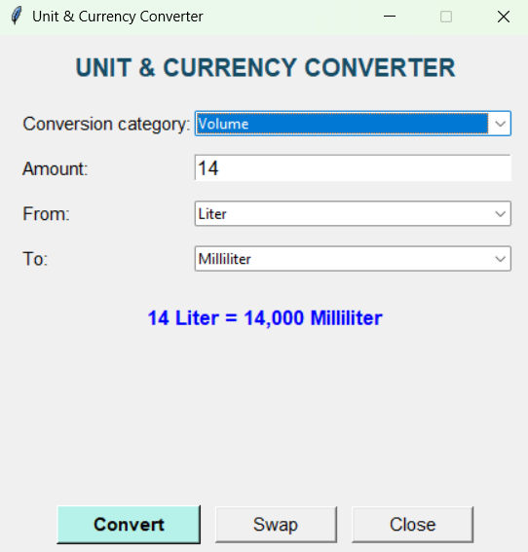
Unit and Currency Converter
An additional feature integrated into the Python calculator.
Allows users to convert values between different measurement units and currencies.
Provides a simple and user-friendly interface.
Category | Conversion examples
Length | Meter, Kilometer, Centimeter, Millimeter, Mile
Weight | Gram, Kilogram, Milligram, Pound
Volume | Millilitre, Liter, Cubic Meter, Gallon
Currency | INR, USD, EUR, GBP, AED

Slide 8
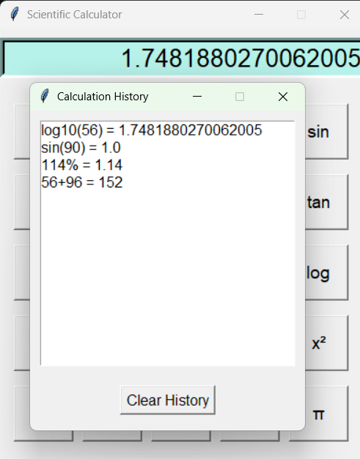
Calculation History
History log
Stores recent expressions and their results during the application session, allowing users to review earlier work.
Example history view
# | Expression | Result
1 | 25 × 4 | 100
2 | √(225) | 15
3 | sin(30°) | 0.5

Slide 9
Key Challenges & How They Were Addressed
Safe expression evaluation
Prevented unsafe code execution by checking and validating allowed math operators, functions, and inputs
before calculating.
Scientific accuracy
Handled tricky situations consistently, such as dividing by zero, invalid math domains, precision limits, and
degree/radian settings.
BMR input validation
Checked that user inputs age greater than 18 years like height, weight, and age are positive realistic and
completely filled out before running calculations.
Graph plotting
Handled invalid math expressions, picked useful ranges for the x-axis, and kept charts clean and easy to read.
Currency Conversion
Currency conversion will work with internet connection only as its require current exchange rate.

Slide 10
Testing & Validation
Scientific calculator
Check arithmetic, trigonometric functions, logarithms, powers, invalid expressions and division by zero.
BMR calculator
Verify sample calculations and reject blank, non-numeric or non-positive measurement inputs.
Graph plotter
Test linear, quadratic and trigonometric functions; invalid syntax; and different x-range values.
History
Confirm entries are added, recalled and cleared correctly; test memory operations.
User interface
Check button actions, display updates, clear/reset behaviour and application stability.

Slide 11
Thank you

